Slide 1
Item List

Slide 2
Item List (Apr 30 2019)
Type | Item Name | Components | Delivery State | Testing State
Drone | DJI M600 Set | M600 body / Ronin-MX Gimbal / 2 RC / Batteries / RTK-GPS |  | Partially done
Drone | DJI M100 Set | M100 body / RC / Propellars / Batteries / A3 FC / Lightbridge |  | Partially done
Drone | DJI Mavic Air Set |  |  | Done
IMU | Spatial |  | Not delivered yet | Not done yet
UWB | TimeDomain | 5 UWB modules / 5 Batteries |  | Done
UWB | Pozyx |  | Not delivered yet | Not done yet
LiDAR | GeoSLAM | Scanner / Data logger / Dongle USB |  | Done
LiDAR | Velodyne Puck LITE |  |  | Not done yet
LiDAR | Velodyne Puck Hi-Res |  |  | Not done yet
LiDAR | Velodyne HDL-32E |  |  | Not done yet
Camera | Sony A7III |  | Not delivered yet | Not done yet
Camera | FLIR Duo R |  | Not delivered yet | Not done yet
Camera | ZED stereo |  | Not delivered yet | Not done yet
Camera | RealSense Depth |  |  | Not done yet
Computer | Intel NUC1 |  |  | Done
Computer | Intel NUC2 |  |  | Done
Computer | NVIDIA TX2 |  |  | Not done yet
Sub-device | Wifi router |  |  | Done
Sub-device | Laser distance |  |  | Done
Sub-device | Label maker
 | Mini Prism |  |  | Done
Battery | Large1 |  |  | Done
Battery | Large2 |  |  | Done
Battery | Payload silver |  |  | Done
Solid | Tripod |  |  | Done
Solid | Chair |  |  | Done
Solid | Table |  |  | Done

Slide 3
DJI M600 Set

Slide 4
DJI M600 Set (1/)
To be added...

Slide 5
DJI M100 Set

Slide 6
DJI M100 Set (1/)
To be added...

Slide 7
DJI Mavic Air Set

Slide 8
DJI Mavic Air Set (1/)
To be added...

Slide 9
TimeDomain UWB P440

Slide 10
TimeDomain UWB P440 (1/)
To be added...

Slide 11
GeoSLAM

Slide 12
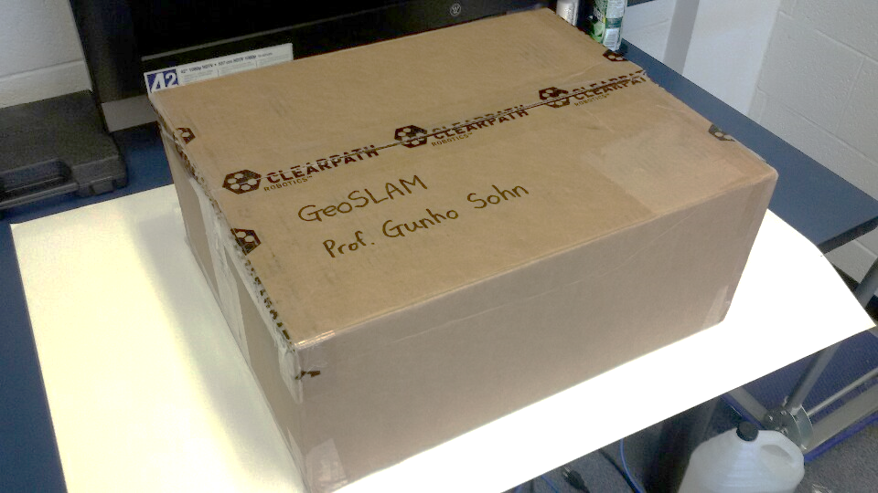
GeoSLAM (1/4)

Slide 13
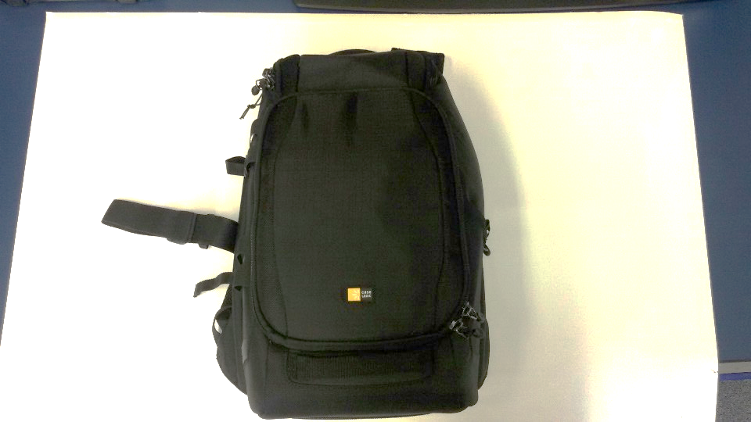
GeoSLAM (2/4)

Slide 14
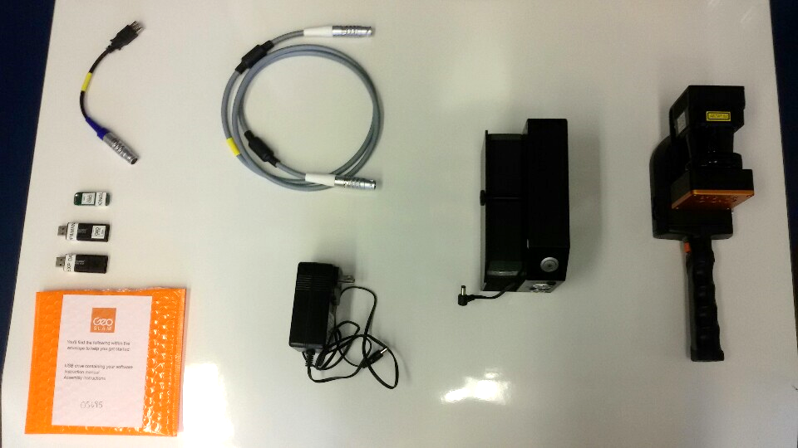
GeoSLAM (3/4)

Slide 15
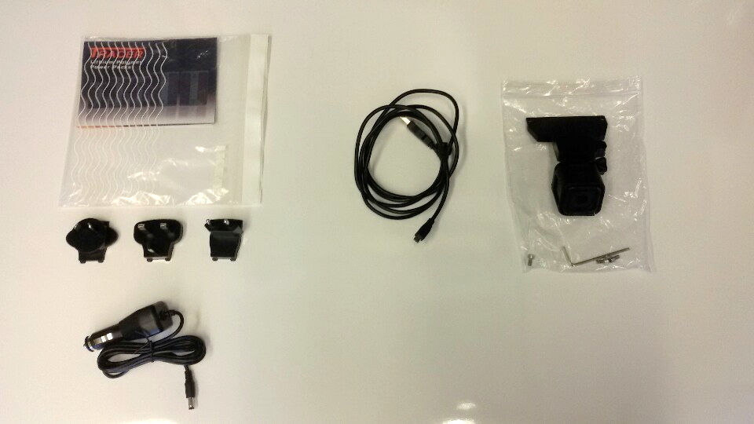
GeoSLAM (4/4)

Slide 16
Velodyne Puck LITE

Slide 17
Velodyne Puck LITE (1/)
To be added...

Slide 18
Velodyne Puck Hi-Res

Slide 19
Velodyne Puck Hi-Res (1/)
To be added...

Slide 20
Velodyne HDL-32E

Slide 21
Velodyne HDL-32E (1/)
To be added...

Slide 22
Intel RealSense D435

Slide 23
Intel RealSense D435 (1/)
To be added...

Slide 24
Intel RealSense D435
It was borrowed from Prof. Mozhdeh.

Slide 25
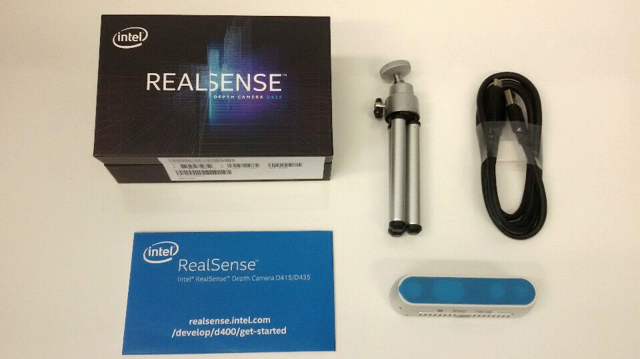
Intel RealSense D435 (1/1)

Slide 26
Intel NUC1

Slide 27
Intel NUC1 (1/)
To be added...

Slide 28
Intel NUC2

Slide 29
Intel NUC2 (1/)
To be added...

Slide 30
NVIDIA Jetson TX2

Slide 31
NVIDIA Jetson TX2 (1/)
To be added...

Slide 32
Wifi Router

Slide 33
Wifi Router (1/)
To be added...

Slide 34
Laser Distance Measurer

Slide 35
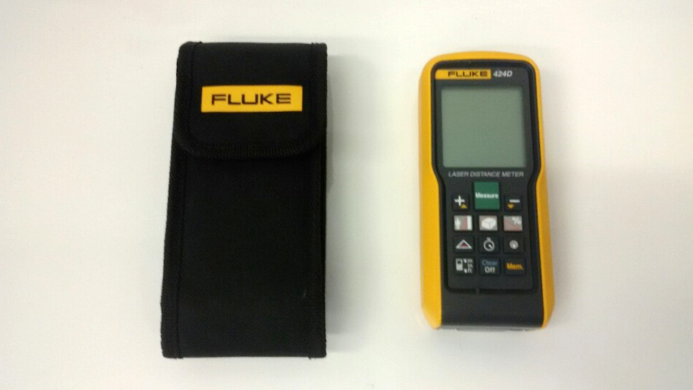
Laser Distance Measurer (1/1)

Slide 36
Label Maker

Slide 37
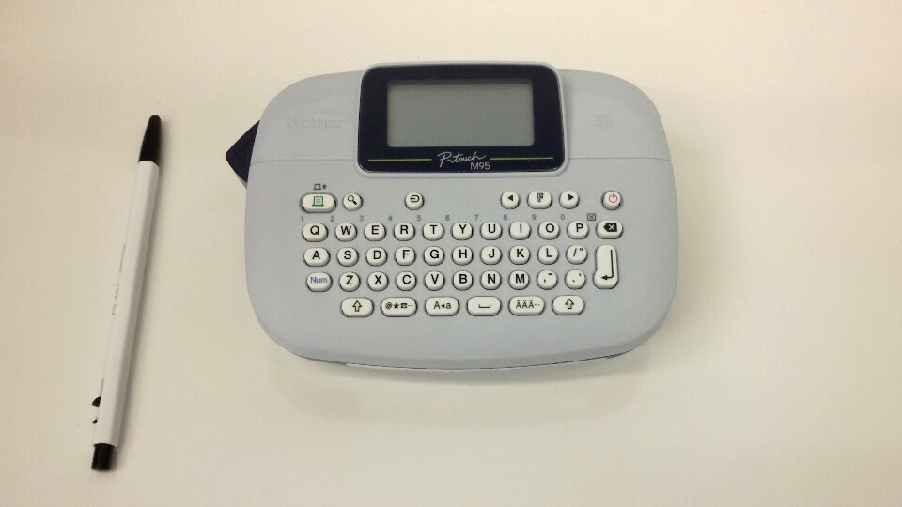
Label Maker (1/1)

Slide 38
Mini Prism

Slide 39
Mini Prism (1/)
To be added...

Slide 40
Battery Large1

Slide 41
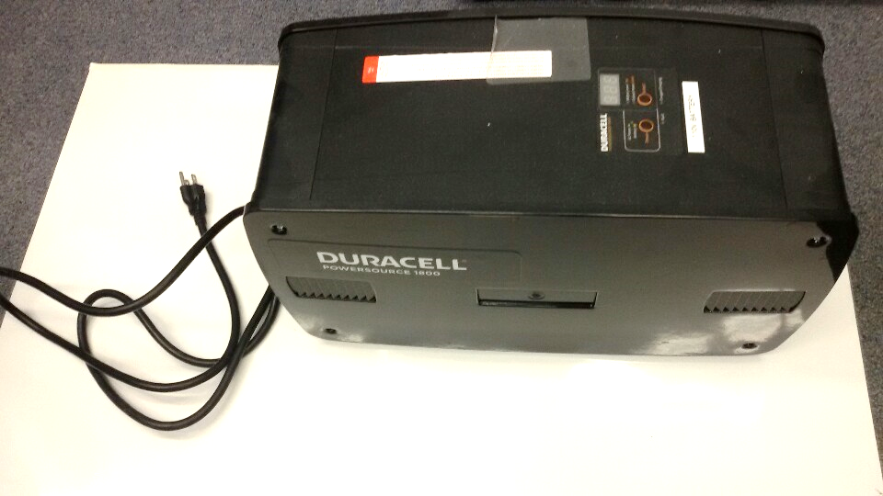
Battery Large1 (1/1)

Slide 42
Battery Large2

Slide 43
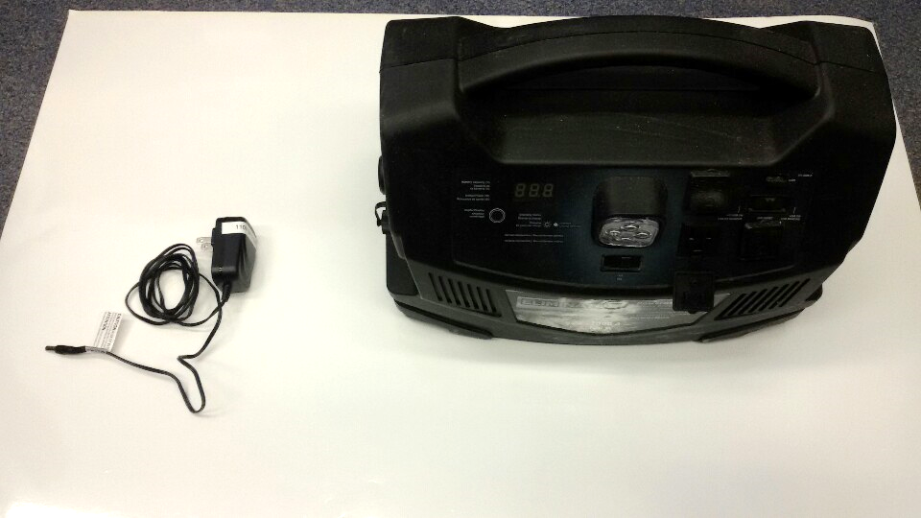
Battery Large2 (1/1)

Slide 44
Battery Payload Silver

Slide 45
Battery Payload Silver (1/)
To be added...

Slide 46
Tripod

Slide 47
Triopod (1/)
To be added...

Slide 48
Chairs

Slide 49
Chairs (1/)
To be added...

Slide 50
Table

Slide 51
Table (1/)
To be added...

